Slide 1

Memory Interfacing
Unit-2
M.SIVA SRINIVASA RAO
ASST. PROFESSOR
ECE

Slide 2
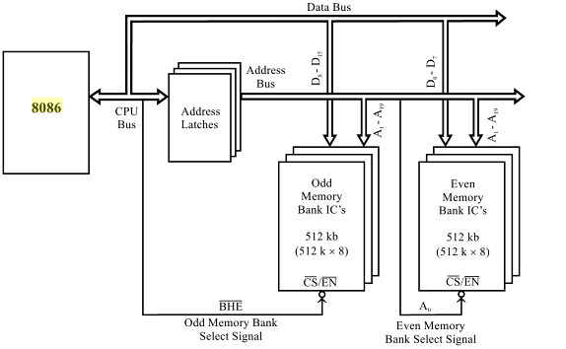
PHYSICAL MEMORY ORGANIZATION in 8086-BASED SYSTEM

Slide 3
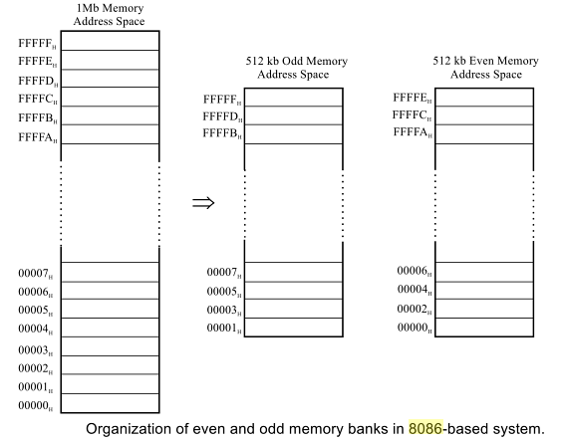
PHYSICAL MEMORY ORGANIZATION cont’d...

Slide 4
PHYSICAL MEMORY ORGANIZATION cont’d...
The 8086 microprocessor provides a 20-bit address to memory.
The memory is organized as a linear array of up to 1 MB, addressed from
00000H to FFFFFH.
The 1MB of 8086 addressable memory space is divided into 2 banks :
Even memory bank and Odd memory bank.
Each bank will have an addressable space of 512 kB.
In 8086-based system the lower 8 lines of data bus, Do- D₇, are connected
to even bank memory ICs and
The upper 8 lines of data bus, D₈- D₁₅ are connected to odd bank memory .

Slide 5
PHYSICAL MEMORY ORGANIZATION cont’d...
The processor provides two enable signals and A₀.
These two signals selectively allow reading from or writing into either
an odd byte location, even byte location, or both.
is used to enable the odd bank and
The A₀ address line is used to enable the even bank.
 | A₀ | Indication
0 | 0 | Whole word is received/transmitted [D15-D0 data lines are active]
0 | 1 | Byte from Odd memory bank [D15-D8 data lines are active]
1 | 0 | Byte from Even memory bank [D7-D0 data lines are active]
1 | 1 | Passive

Slide 6
PHYSICAL MEMORY ORGANIZATION cont’d...
A microprocessor-based system requires both EPROM and RAM.
Hence, the available memory space has to be divided between EPROM
and RAM.
This choice depends on the system designer as well as on the application
for which the system is designed.
The system designer should allot equal address space in odd and even
bank for both EPROM and RAM.
The required EPROM memory capacity can be implemented in two Ics
(one for even and the other for odd bank) or in multiple ICs.
Similarly, the RAM capacity of the system can be implemented in two ICs
or in multiple ICs.
This choice depends on the availability of memory IC and the system designer.

Slide 7
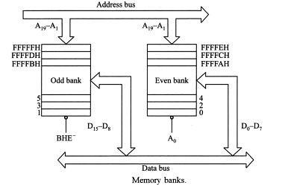
PHYSICAL MEMORY ORGANIZATION cont’d...

Slide 8
PHYSICAL MEMORY ORGANIZATION cont’d...
Some systems may require large memory space and so full memory
space is utilized.
But in some systems, the memory requirement may be less and in this case
the full memory space is not utilized.
When full memory space is not utilized for memory, then the unused
memory addresses can be used for addressing I/O devices.
Such I/O devices are called memory-mapped I/O devices and they can be
accessed similar to that of memory device.

Slide 9
I/O Addressing or I/O Interfacing
The I/O devices in 8086 may be interfaced with 8086 in two different ways.
i) I/O mapped I/O and ii) memory mapped I/O.
These two methods of I/O interfacing give rise to two different
I/O address spaces.

Slide 10
I/O ADDRESSING cont’d..
I/O Mapped I/O
The I/O Mapped I/O is also known as Isolated I/O.
Here the I/O devices are treated as I/O devices only.
The I/O Mapped I/O interfacing may be of two types, viz.
I/O devices having 8-bit port addresses and
I/O devices having 16-bit addresses.
In the first case, microprocessor 8086 can address up to 256 (2⁸) input devices
as well as 256 output devices.
In the second case, microprocessor 8086 can address up to 64K (2¹⁶) input
devices as well as 64K (2¹⁶) output devices.
The address of the I/O device is called the port address.
The control signals used in this space are and .
In this technique of interfacing, there are only two instructions for
data transfer between an I/O device and microprocessor.
These instructions are IN and OUT.

Slide 11
Memory Mapped I/O
In memory mapped I/O, the I/O devices are allotted 20-bit addresses.
This can be understood as that a memory register have been replaced by an
I/O device.
Now the I/O device has the address of a memory.
In memory mapped I/O we can interface 1M input/ output devices with
8086. The I/O locations in memory mapped I/O is considered as a memory
location.
The memory related control signals ( and ) are used to read
and write from the I/O.
All the memory related instructions are used to access an I/O.

Slide 12
Difference between I/O mapped I/O and memory mapped I/O
I/O mapped I/O | Memory mapped I/O
8- or 16-bit port address. | 20-bit port address.
Maximum 256 I/O ports can be interfaced using direct addressing and 64K I/O ports can be interfaced using indirect addressing. | 1M I/O ports can be interfaced.
Less address decoding hardware is required as only 8 address bits are to be decoded. | More address decoding hardware is required because in this case 16 address bits are to be decoded.
& will be the control signals. IN and OUT are the only instructions for data communication between the microprocessor and the I/O devices. | & are the control signals. Any memory related instructions, such as MOV etc. can be used for data communication between the microprocessor and the I/O devices.
I/O can communicate only with the accumulator. | I/O can communicate with any of the registers, just like a memory register.
I/O and memory can have the same address. | I/O and memory cannot have the same address.
There is no effect on memory size. | Memory size will reduce.
Arithmetic and logic operations cannot be performed directly on the data at I/O. | Arithmetic and logic operations can be performed directly on the data at I/O.

Slide 13
Memory Interfacing
Semiconductor memories are organized as two dimensional arrays of
memory locations.
For example, 4K x 8 or 4K byte memory contains 4096 locations,
where each location contains 8-bit data and only one of the 4096 locations
can be selected at a time.
Once a location is selected all the bits in it are accessible using a group of
conductors called 'data bus'.
For addressing 4K bytes of memory, 12 address lines are required.
In general, to address a memory location out of N memory locations
we require at least n bits of address. i.e. n address lines where n = Log₂N.
Thus if the microprocessor has n address lines, then it is able to address
at the most N locations of memory, where 2^{n}= N.

Slide 14
Memory Interfacing Cont’d…
The least significant p address lines out of the available n lines can be
directly connected from the microprocessor to the memory chip .
While the remaining (n-p) higher order address lines may be used for
address decoding (as inputs to the chip selection logic).
The memory address depends upon the hardware circuit used for decoding
the chip select
The output of the decoding circuit is connected with the pin of
the memory chip.

Slide 15
Memory Interfacing Cont’d…
The general procedure of static memory interfacing with 8086 is briefly
described as follows:
1. Arrange the available memory chips so as to obtain 16-bit data bus width.
Connect the upper 8-bits of data bus to 'odd address memory bank' and the
Connect the upper 8-bits of data bus to 'odd address memory bank‘ .
2. Connect the 16-bit data bus of the memory bank with that of the 8086.
3. Connect available memory address lines of memory chips with those of
the microprocessor and also connect the memory inputs to the
corresponding processor control signals.
3. The remaining address lines of the microprocessor , and A₀ are used for
decoding the required chip select signals for the odd and even memory banks.
The of memory is derived from the O/P of the decoding circuit.

Slide 16
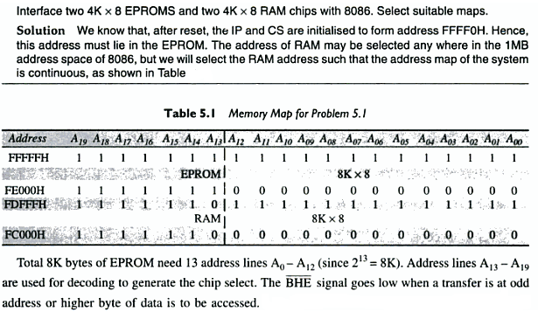
Problem 1:

Slide 17
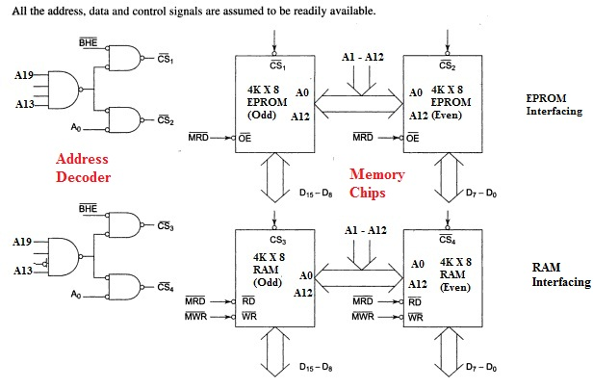
Problem 1: cont’d…

Slide 18
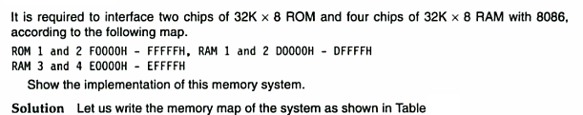
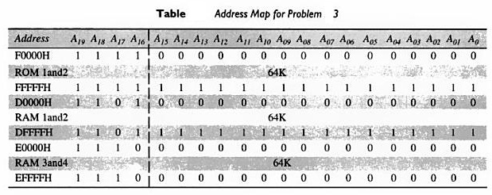
Problem 2 :

Slide 19
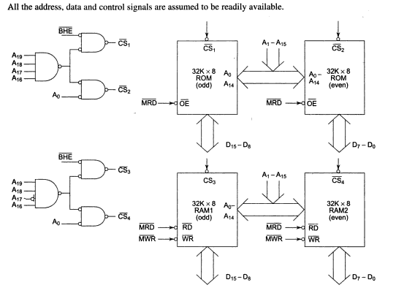
Problem 2 : cont’d…
ROM Interfacing

Slide 20
Problem 2 : cont’d…
RAM 1 & 2 Interfacing

Slide 21
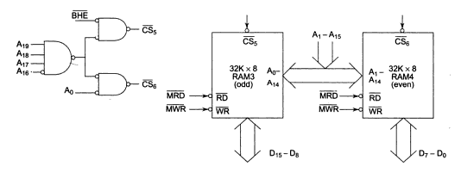
Problem 2 : cont’d…
RAM 3 & 4 Interfacing

